Slide 1

MisplaceX Project Progress
TMP-23-345

Slide 2
TEAM MEMBERS
Superviosr : Dr. Lakmini Abeywardhana
Co-supervisor : Ms. Amali Gunasinghe
Student name | STUDENT ID
Herath H.M.C.S.B | IT19108100
Jasin Arachchi K.T | IT20110802
Gunathilaka S.B.M.B.S.A | IT20028046
Jathurshan S | IT19130408

Slide 3

RESEARCH PROBLEM
The use of IoT devices in server rooms and data centres is becoming increasingly important due to their reliance on them for efficient communication, data storage, and processing. However, their misplacement or unauthorized access can lead to data breaches, downtime, and other negative consequences.

Slide 4
OBJECTIVE
Implement an effective user anomaly detection system to office environments and critical workstations.
Use Artificial intelligence to face Challenging Information Technology market and improve analytical and critical thinking.
Developing a mechanism for managing authorized devices and creating a whitelist of approved devices to ensure only authorized devices are allowed in the office area.
Extraordinary approach to surpass traditional security measures and introducing efficient and low-cost Security monitoring system while using user-friendly interface for easier device management and control.

Slide 5

01
IT19130408 Jathurshan S BSc (Hons) Degree in Information Technology (specialization in Computer Systems and Network Engineering)
COMPONENT

Slide 6
Implement a real-time monitoring system for devices in an office environment

Slide 7
Background
The security of office environments is a critical concern.
Miss placement of devices is a common problem.
Traditional security measures are expensive and ineffective.
Implementation of a real-time monitoring system using image processing for devices in an office environment can help to improve the security of the environment.

Slide 8
Research Problem
The lack of an accurate and reliable real-time device detection and monitoring system for IoT devices in office environments using image processing and machine learning.
Research Question
How can image processing and machine learning techniques be used to develop an accurate and reliable real-time device detection and monitoring system for IoT devices in office environments, and how effective is this system in detecting unauthorized and missing devices?

Slide 9
OBJECTIVES
Sub Objectives
Main Objective
Identify the key factors that can influence the design and effectiveness
Identify the limitations and potential areas for improvement
Conduct experiments to evaluate the effectiveness of the system
Compare the performance with existing systems
Provide recommendations for the enhancing office security
Design and implement a real-time monitoring system using image processing and machine learning for devices in an office environment.

Slide 10
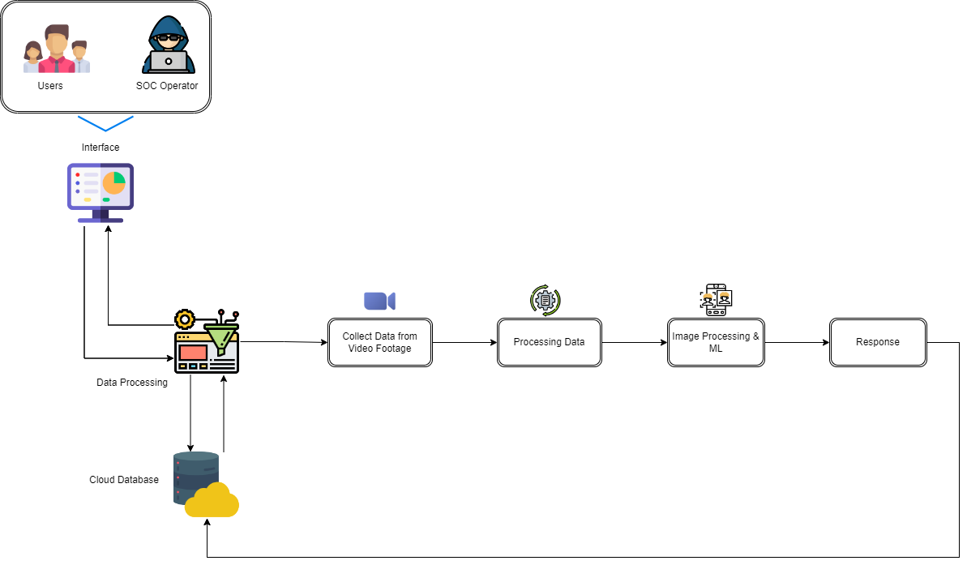
OVERVIEW DIAGRAM

Slide 11
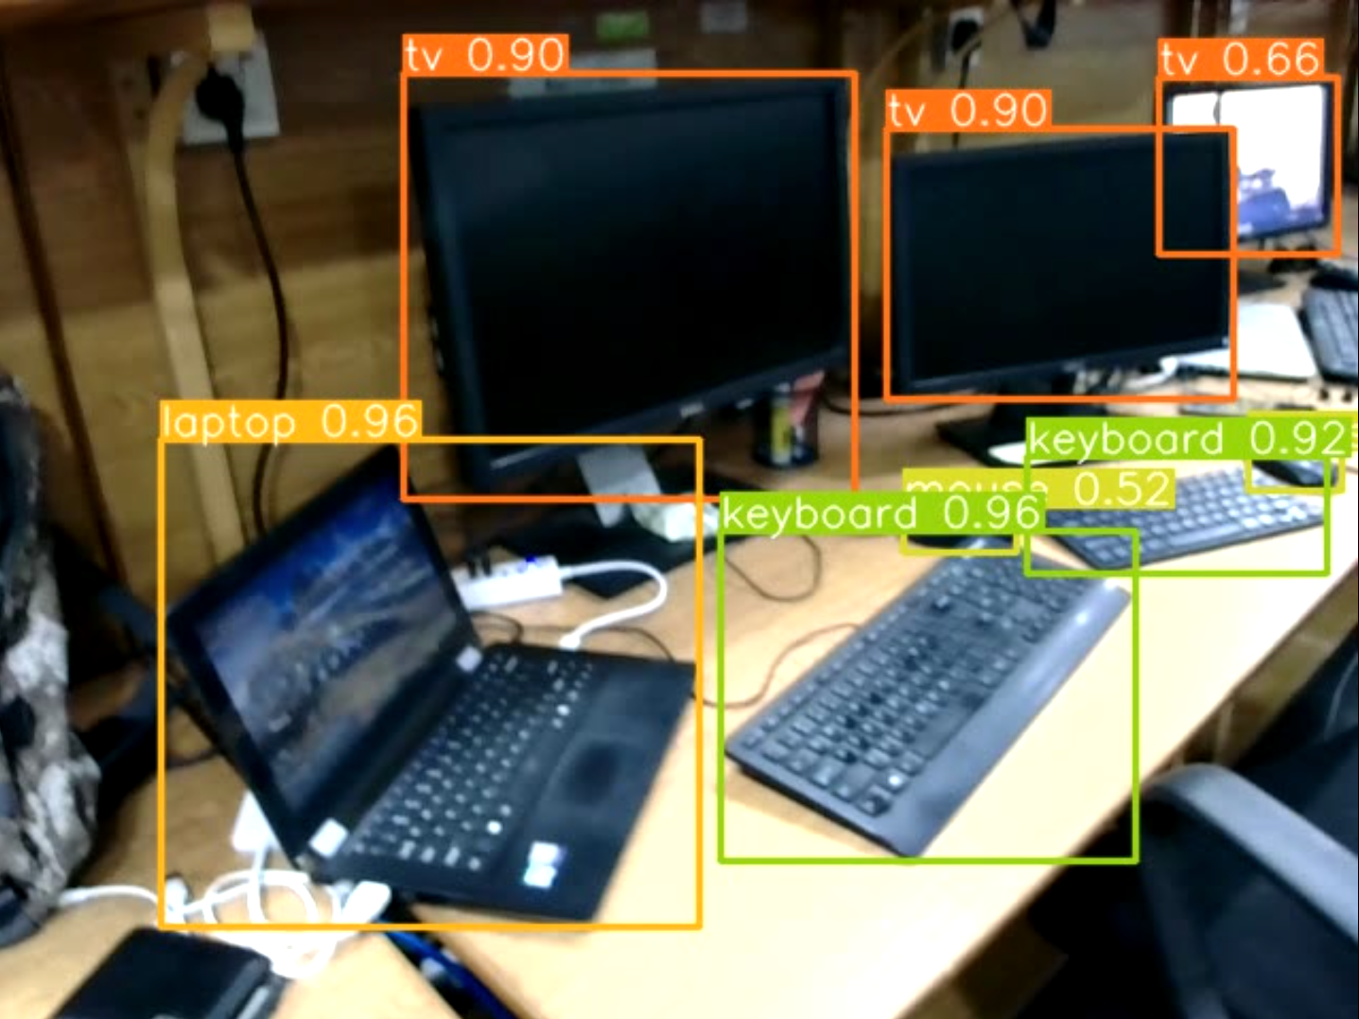
Current Progress
Monitoring devices in real-time
Give an alert if any of the device is missing

Slide 12
Future Progress
Develop a separate platform for monitoring
Give an Email and SMS alert if any of the device is missing
Improve the accuracy

Slide 13

02
IT19108100 Herath H.M.C.S.B
COMPONENT
BSc (Hons) in Information Technology Specialising in Cyber Security

Slide 14
INTRODUCTION
Whitelisting and Rogue Device Detection in IT device detection and monitoring systems in office environments
Develop a whitelist mechanism for authorized devices in IT device detection and monitoring within office environments.
Develop a mechanism to detect, alert, and handle rogue devices seamlessly.
Ensure precise control over device access, log all attempts, and blacklist removed or suspicious devices to prevent unauthorized access.
Processed image data, led the development of the interface and database, and integrated rogue detection algorithms.
Aim to significantly enhance the security framework of IT device detection and monitoring systems in office settings, with an emphasis on preempting rogue device threats.
Preserve the integrity and security of office IT environments through comprehensive device management, from whitelisting to rogue detection.

Slide 15
RESEARCH GAP
There are existing studies done on the topic of “whitelist of authorized devices ”
Lack of detailed mechanism for controlling access to devices based on a whitelist (Bursztein et al., 2014)
Lack of attention given to the management of authorized devices (Joshi et al., 2015)
Not addressing the specific challenge of managing authorized devices (Cheung et al., 2017)
Not addressing the challenge of managing authorized devices and ensuring only approved devices are allowed in the office environment (Xu et al., 2019)
The novelty of our proposed work
Developing a system that combine multiple data points for a robust rogue device detection methodology.
Developing a mechanism for managing authorized devices and creating a whitelist of approved devices to ensure that only authorized devices are allowed in the office area.
Providing more granular control over device access, logging and reporting device access attempts, and blacklisting devices that have been removed from the office environment to prevent unauthorized access.
Enabling real-time reporting and notifications on device access attempts to enable more proactive threat detection and response.

Slide 16
Main Objective
Developing a mechanism for managing authorized devices and creating a whitelist of approved devices to ensure only authorized devices are allowed in the office area.
Design and implement a comprehensive rogue device detection system that combines:
IP address recognition.
Geolocation data.
Secure score evaluations
Sub-Objectives
Process image data and display it in the interface.
Comprehensive Data Collection: Emphasis on IP details, geolocation, and security metrics.
Identification of rogue devices based on parameters.
Real-time Network Monitoring: Constant tracking of active devices to detect anomalies.
Responsive System: Swift alerting, logging, and action mechanism against potential rogue entities.

Slide 17
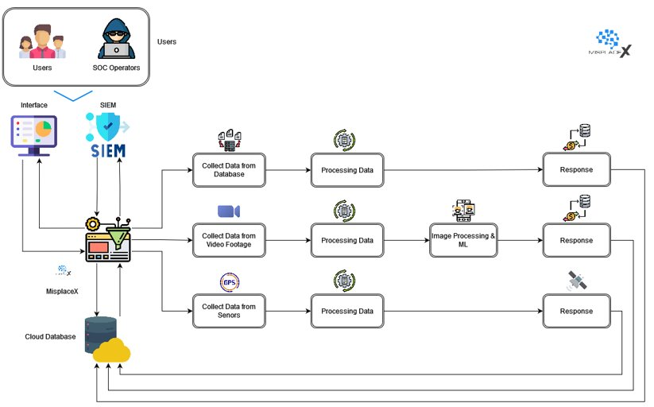
OVERVIEW DIAGRAM

Slide 18
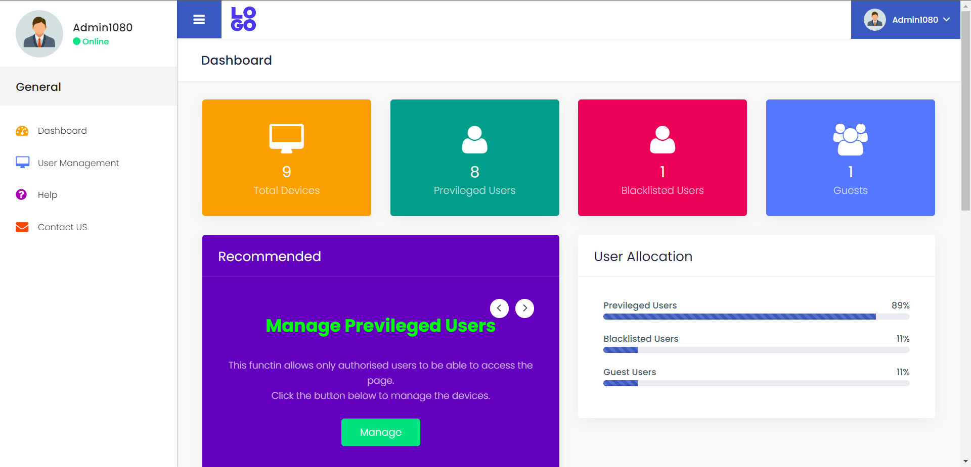
Current Progress – Dashboard

Slide 19
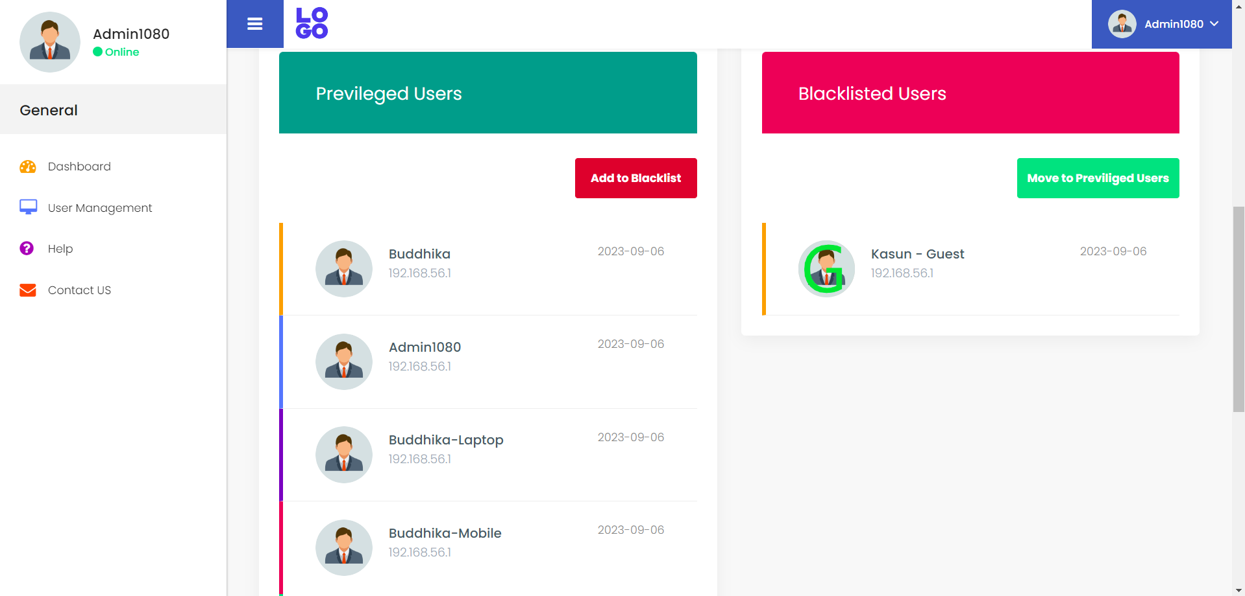
Current Progress – Manage Devices

Slide 20
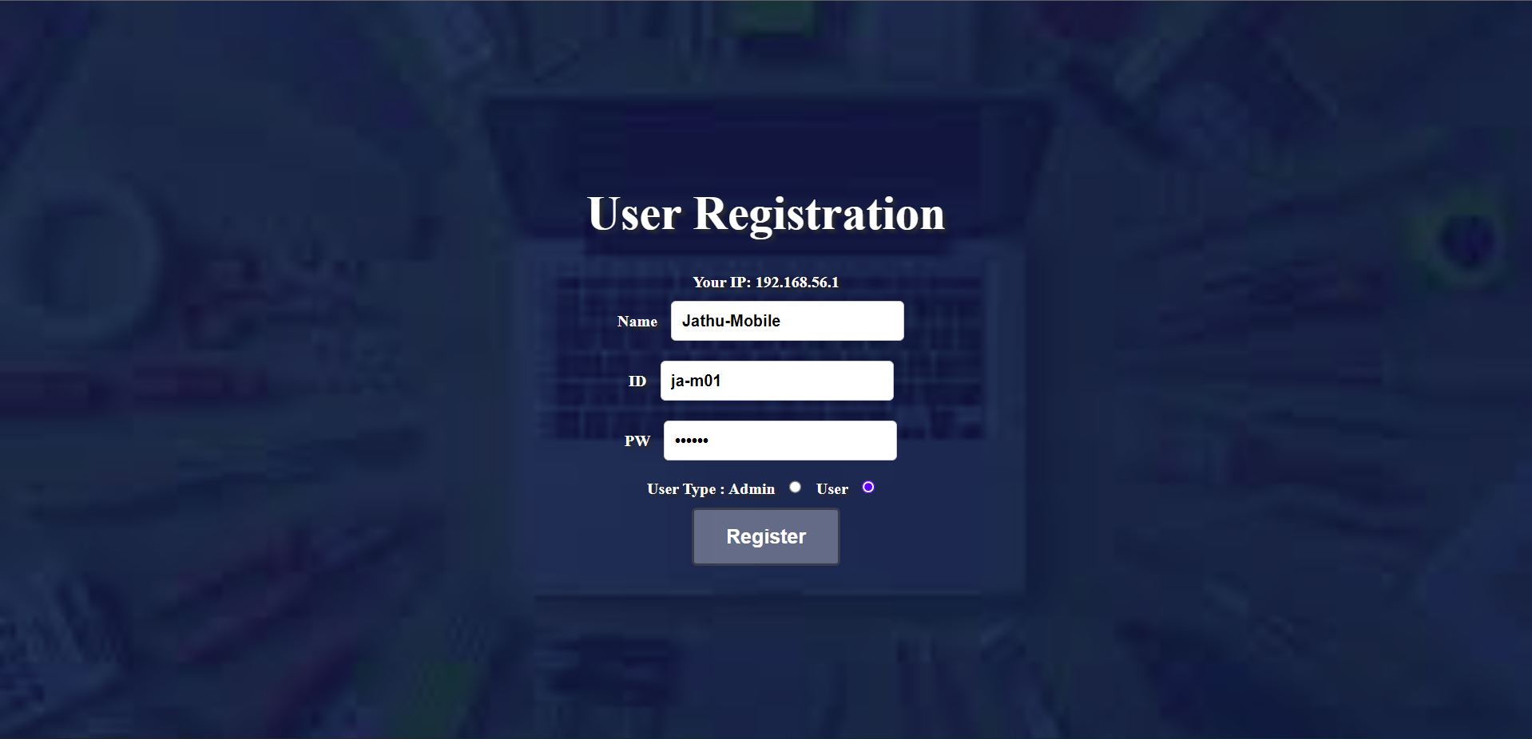
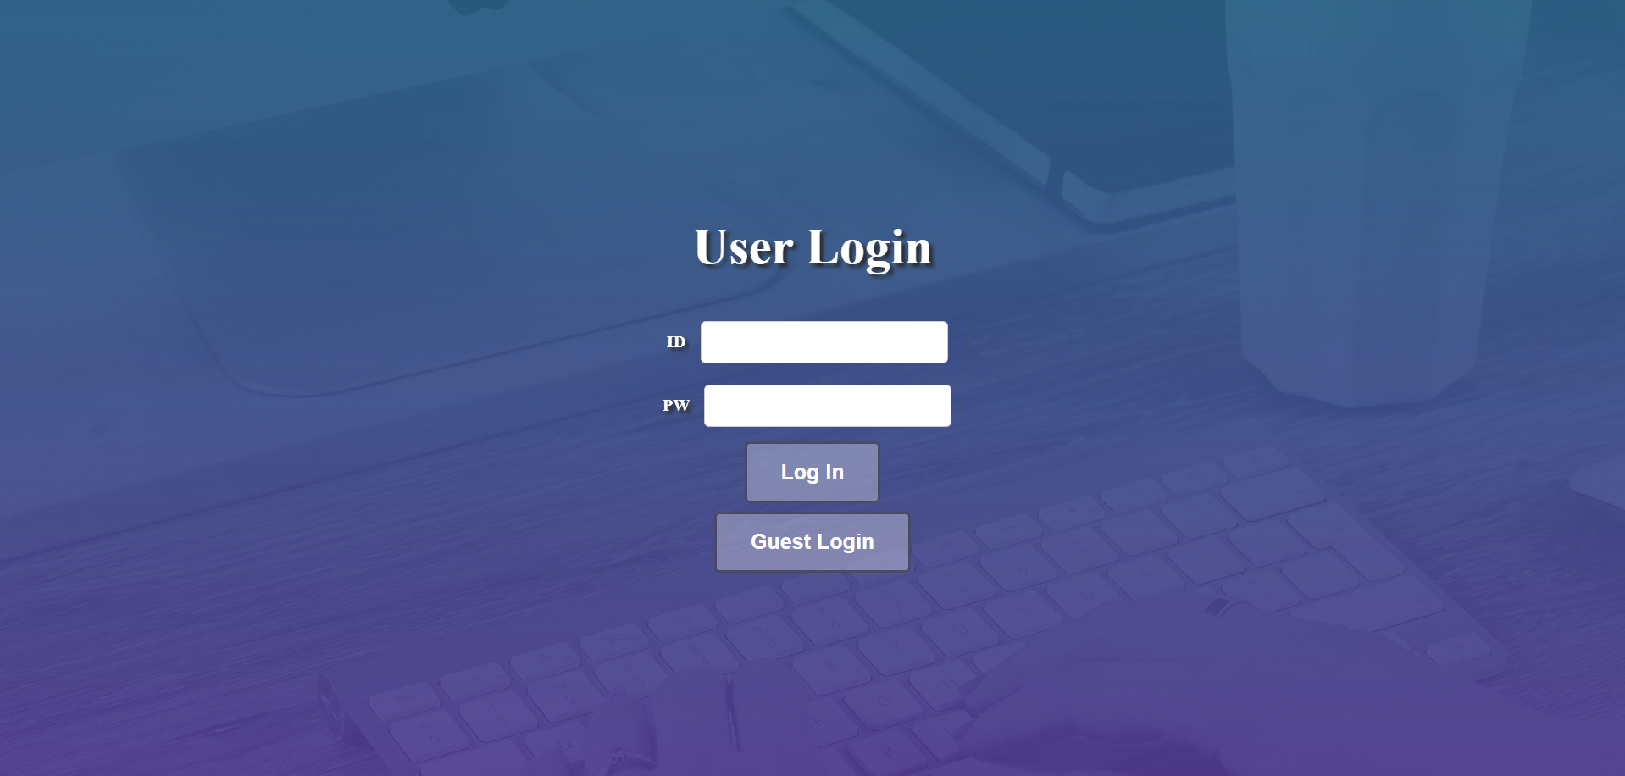
Current Progress

Slide 21
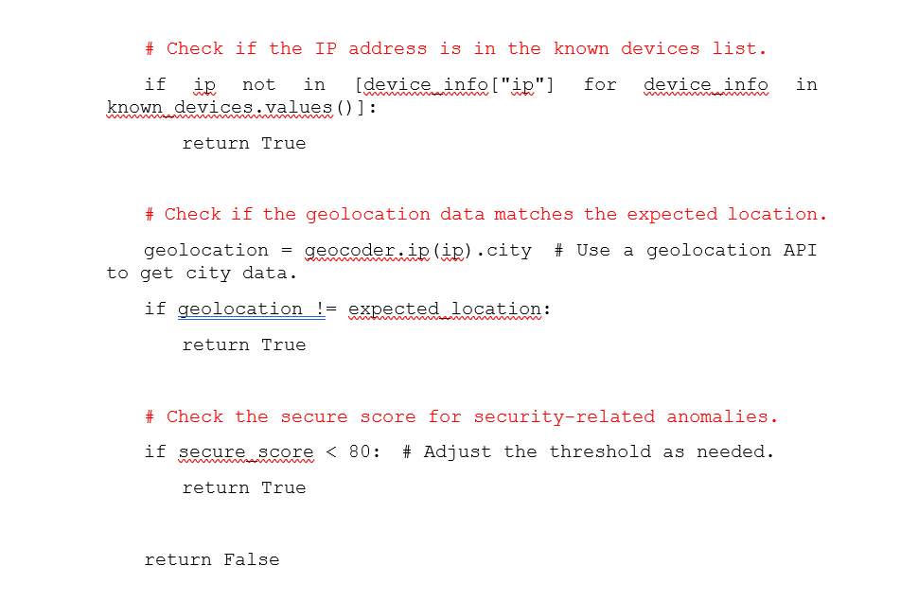
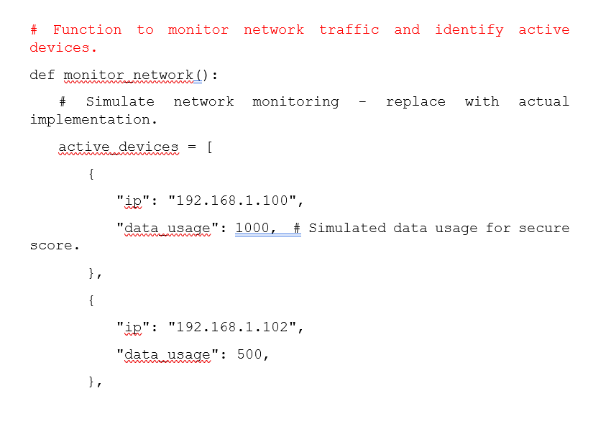
Current Progress - Algorithm

Slide 22

03
IT20028046 Gunathilaka S.B.M.B.S.A
COMPONENT
BSc (Hons) in Information Technology Specialising in Cyber Security

Slide 23
Target problem
Proposed Solution​
The misplacement of devices in critical office areas can be a serious problem, as it can lead to unauthorized access to sensitive data or equipment.
A tracking module will use a GPS to track the location of devices. If a device is misplaced, the module will help to find the location of the device.

Slide 24
Current Progress
Create new 2 prototypes
Instead of Wi-Fi now the module uses GSM to connect to the web app and Database
Higher Accuracy , low power consumption, portability , more convenient
Added constant-voltage linear charger for charge the battery.
False values on web app now fixed

Slide 25
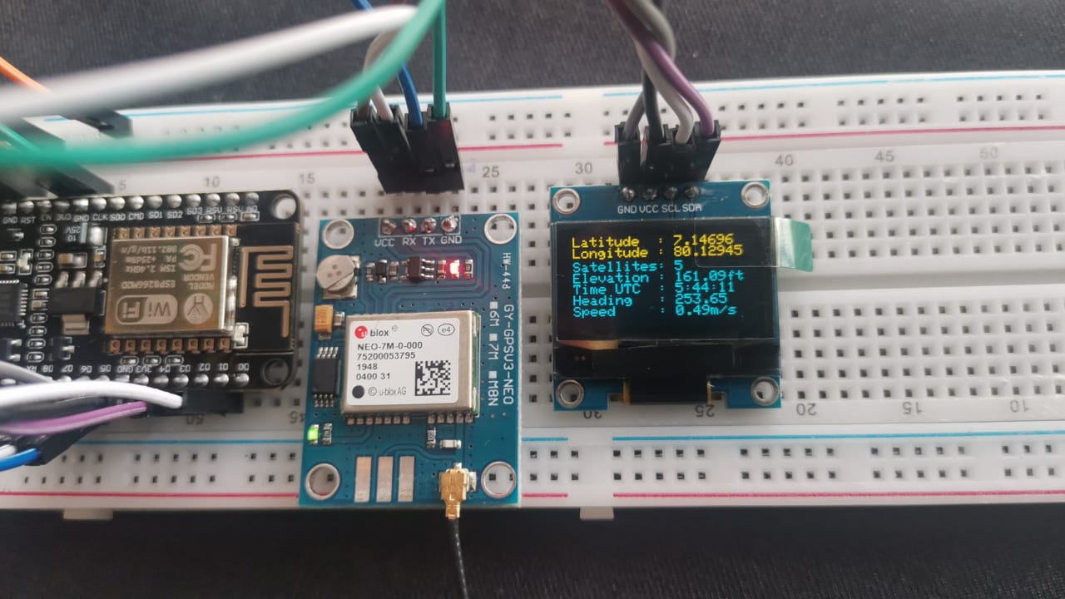
Prototype 1

Slide 26
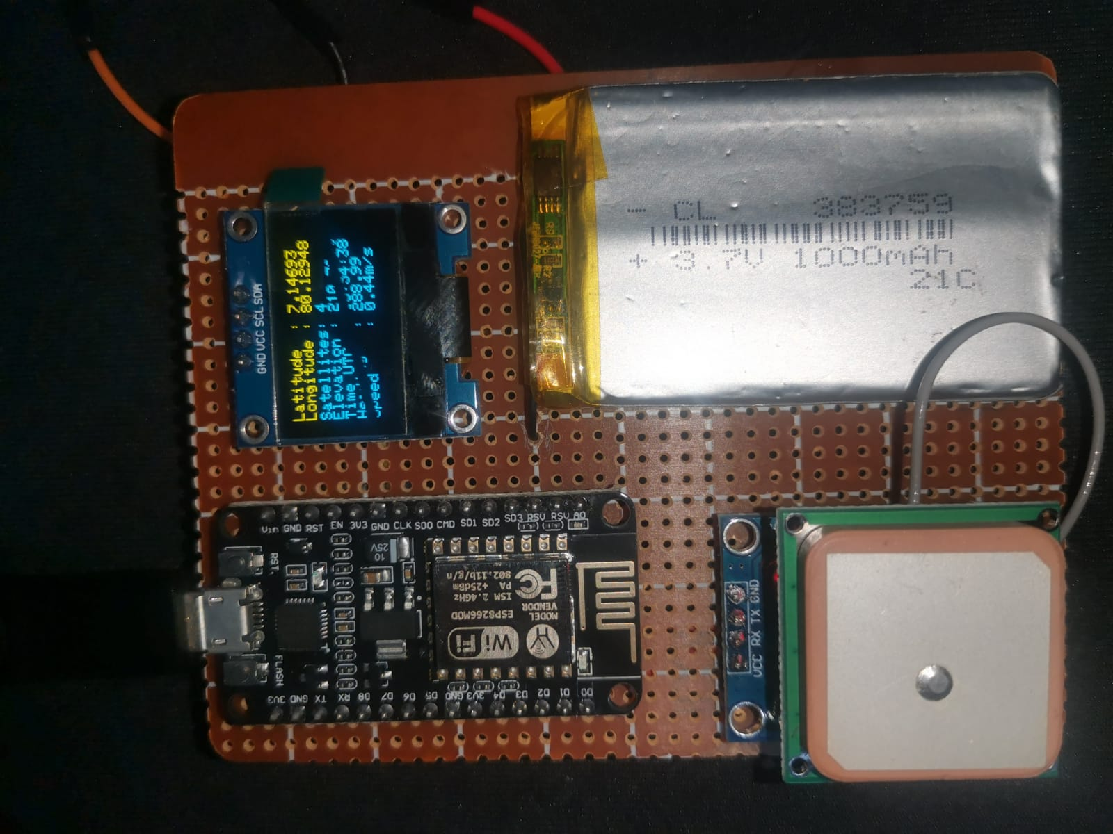
Prototype 2

Slide 27
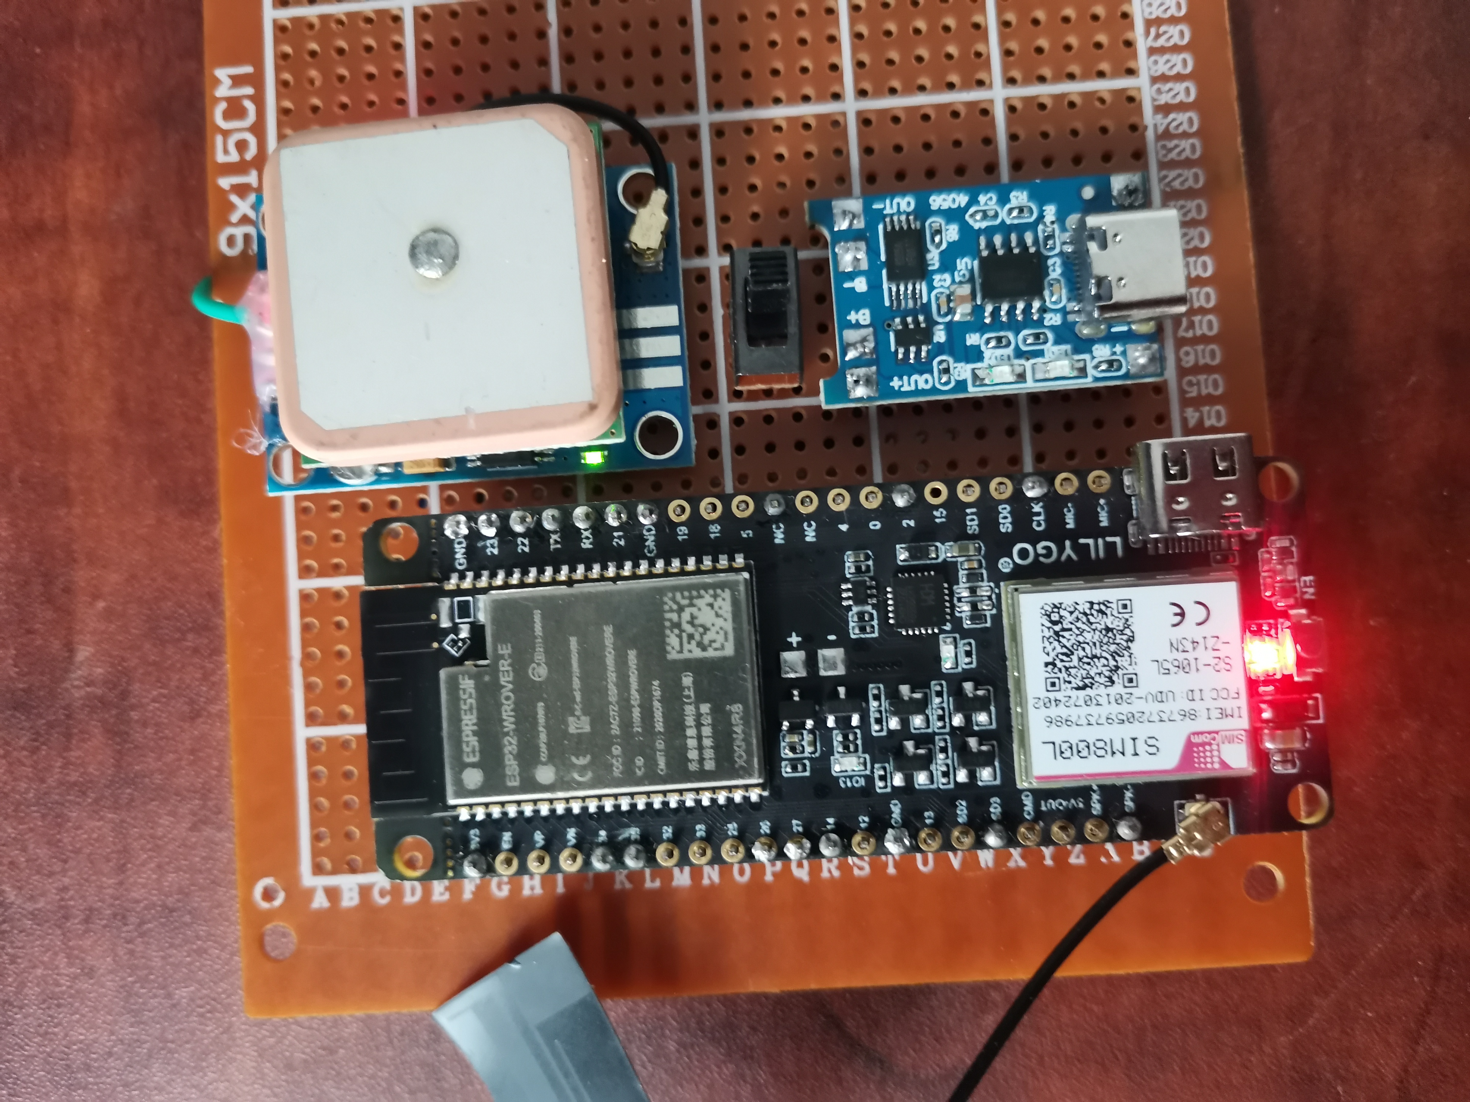
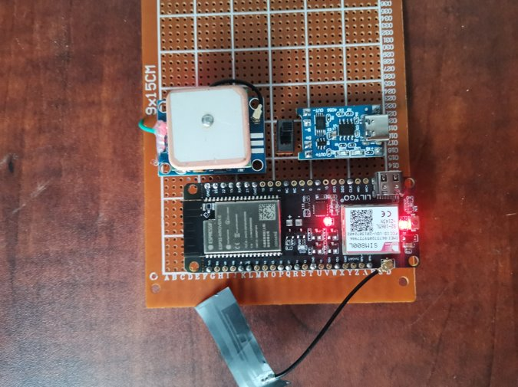
Prototype 3

Slide 28
Future Progress
Update a Realtime database with location info
Exclude current intended location to detect if the device is in the building or not
Enhance overall accuracy and fix bugs

Slide 29


04
IT20110802 Jasin Arachchi K.T
COMPONENT
BSc (Hons) in Information Technology Specialising in Cyber Security

Slide 30
INTRODUCTION
Implement a mechanism to monitor and track user activity on their devices within the office environment
by using SIEM .identifies abnormal behaviour, determines if it has security implications, and alerts
Integration with security operations centre.
Collect anomalies and Monitor a network or system for malicious activity and protects network from unauthorized access from users.
Network intrusion detection methodology using machine learning.
Final report after full integration and test results.

Slide 31
Novelty
Extract all the security anomalies to one place; SIEM and analyse to filter false positives .
Implement a mechanism to intrusion detection to office environment
by extracting raw TCP/IP dump data and extracted anomalies in SIEM.

Slide 32
OBJECTIVES
generate alerts & SIEM
Extract logs and network traffic
Gather suspicious user behavior and logs.-Wazuh
Gather TCP/IP dump data and SIEM log analysis data
build a predictive model
Reporting
build a predictive model to intrusion detection.
Analyzing report history ,Alert trends and create final report

Slide 33
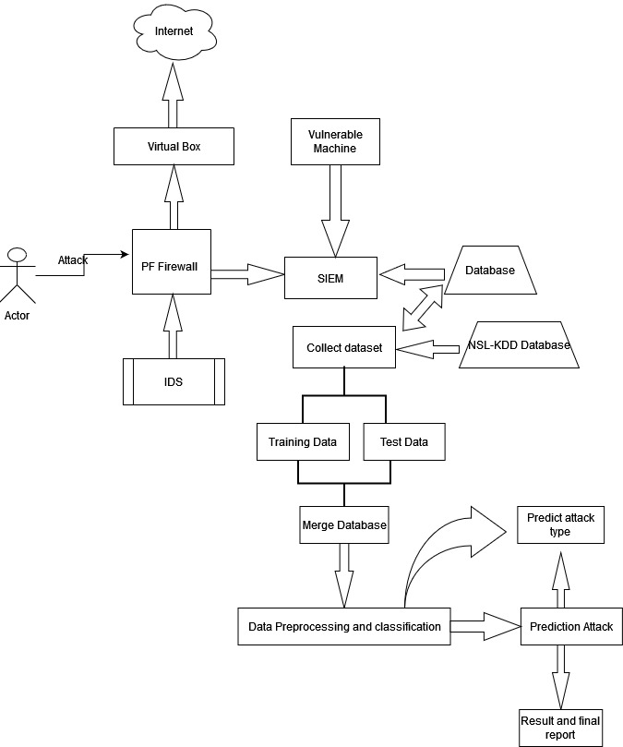
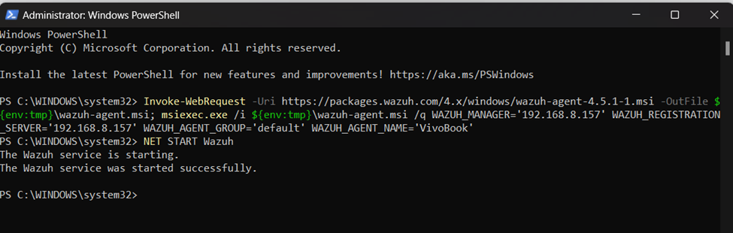
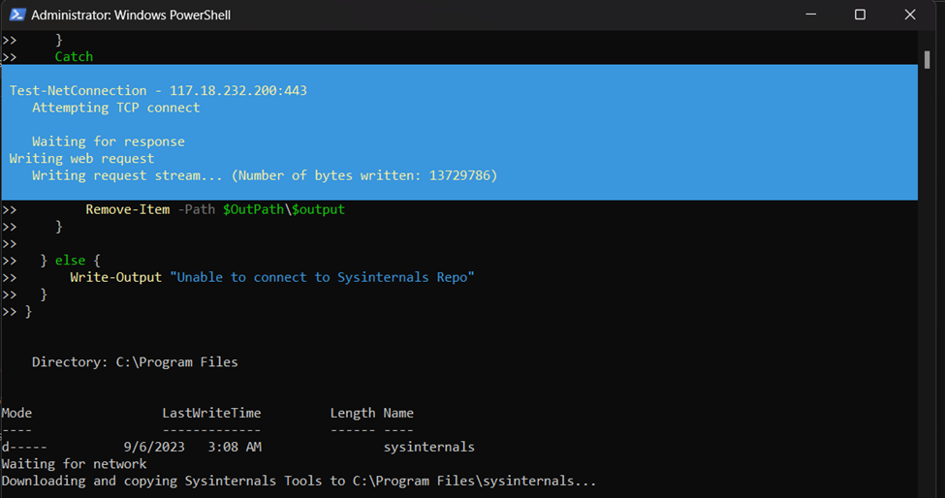
OVERVIEW DIAGRAM & CONFIGURATIONS.

Slide 34
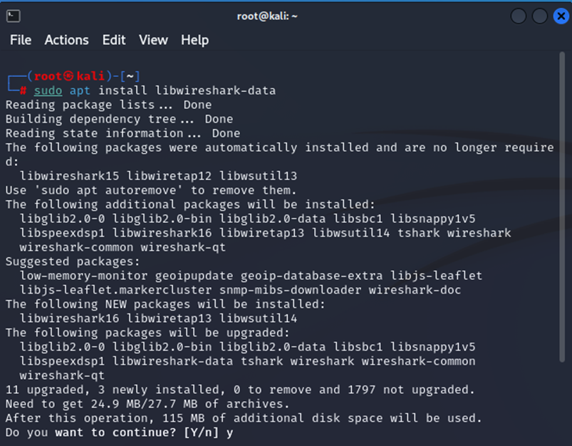
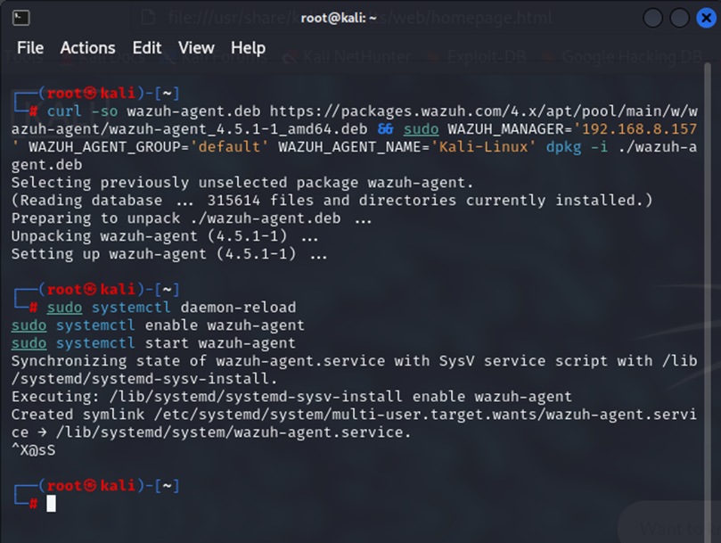
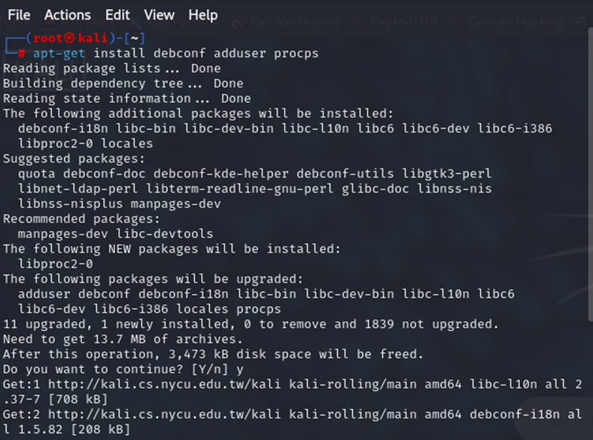
Configurations

Slide 35
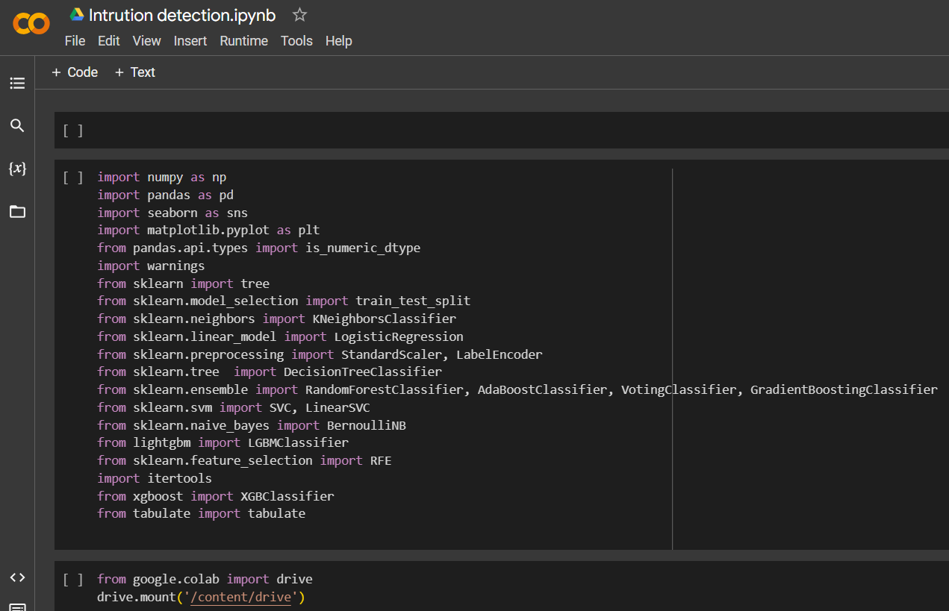
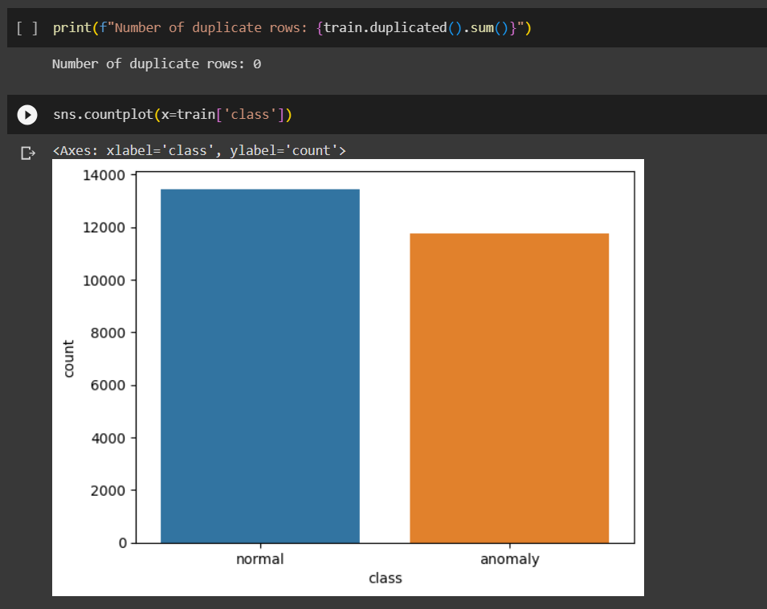
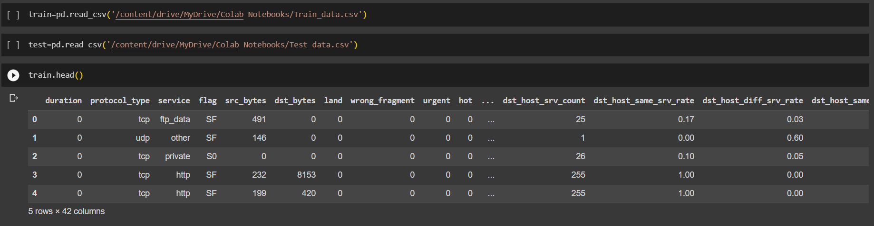

Slide 36
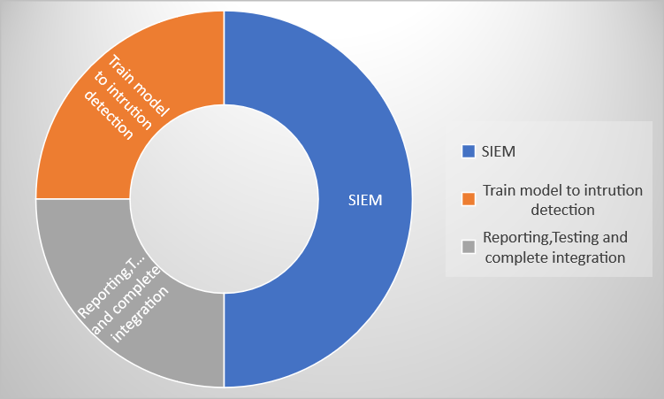
Current Progress
Total Progress-80%
SIEM |  |  |  |  | 45%
Train model to intrusion detection |  |  |  |  | 20%
Reporting, Testing and complete integration |  |  |  |  | 15%

Slide 37
Future Progress
Ingest 1 more agent, Firewall logs and Vulnerability detection to the SIEM - 5%
Include syslog's and firewall logs also to the Training data set and Train and test model after the full integration - 5%
Complete Full integration and test Intrusion detection model - 10%
Overall final report after analyzing alert history ,alert trends - 5%

Slide 38
THANKS!

